Slide 1
Analysis of Liver Cirrhosis
Group: Peiyuan Xu, Eric Shi, Linlin Wang

Slide 2
Agenda
Introduction
Data Visualization
Regression Analysis
Conclusion

Slide 3
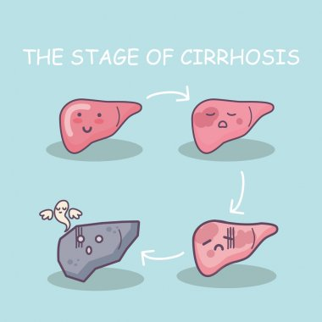
Introduction
Liver cirrhosis is defined as a diffuse process, which is characterized by fibrosis and the conversion of normal liver architecture to abnormal nodules.
Liver cirrhosis occurs when healthy liver cells are damaged and replaced with hard scar tissue.
Four stages.
Healthy Liver
Fatty Liver
Liver Cirrhosis
Liver Fibrosis

Slide 4
Liver Cirrhosis Deaths Statistics in the U.S.
82,284
86,293
104,156
129,939
2000-2002
2005-2007
2010-2012
2015-2017
*Data from statista

Slide 5
Data
Data from Kaggle website.
The data contains the information collected from the Mayo clinic trial in primary biliary cirrhosis (PBC) of the liver conducted between 1974 and 1984.
A total of 418 patients, and 19 features

Slide 6
Dataset
Status | status of the patient C (censored), CL (censored due to liver tx), or D (death)
Drug | type of drug D-penicillamine or placebo
Age | Age
Sex | M (male) or F (female)
Ascites | presence of ascites N (No) or Y (Yes)
Hepatomegaly | presence of hepatomegaly N (No) or Y (Yes)
Spiders | presence of spiders N (No) or Y (Yes)
Edema | presence of edema N (no edema and no diuretic therapy for edema), S (edema present without diuretics, or edema resolved by diuretics), or Y (edema despite diuretic therapy)
Bilirubin | serum bilirubin in [mg/dl]
Cholesterol | serum cholesterol in [mg/dl]
Albumin | albumin in [gm/dl]
Copper | urine copper in [ug/day]
Alk_Phos | alkaline phosphatase in [U/liter]
SGOT | SGOT in [U/ml]
Tryglicerides | triglicerides in [mg/dl]
Platelets | platelets per cubic [ml/1000]
Prothrombin | prothrombin time in seconds [s]
Stage | histologic stage of disease (1, 2, 3, or 4)

Slide 7
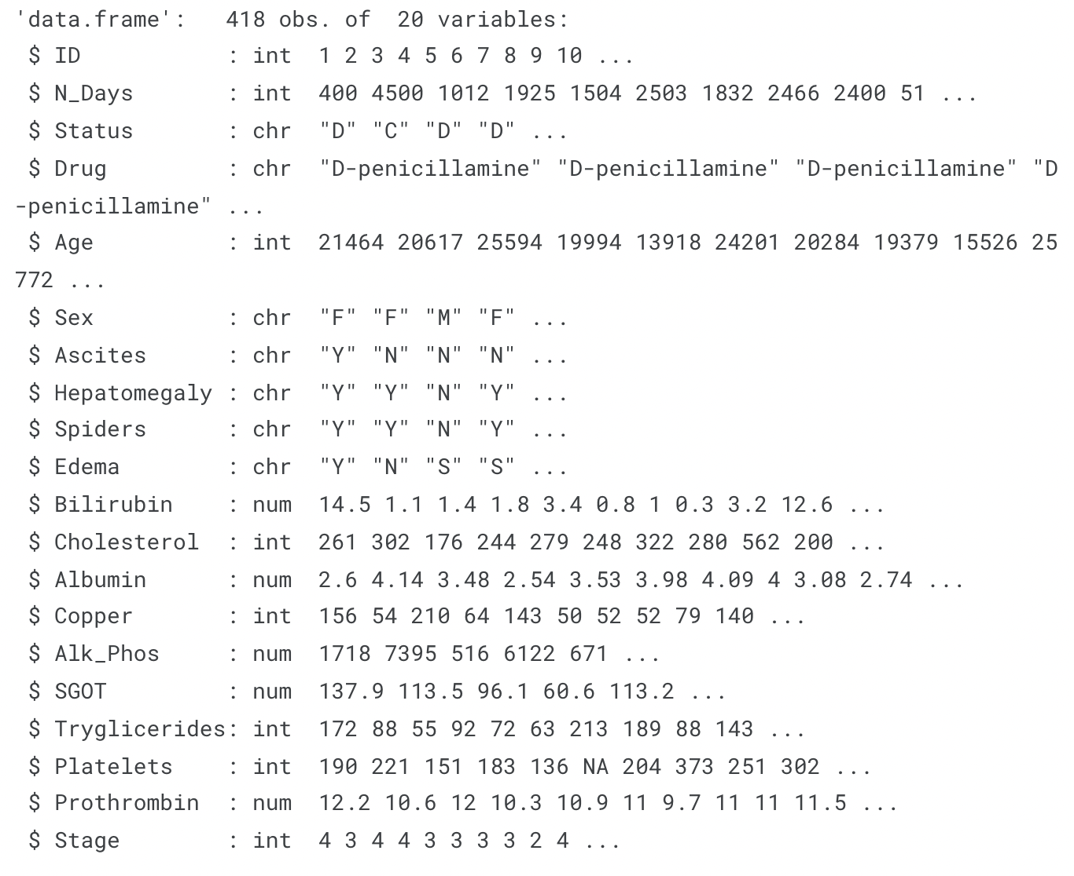
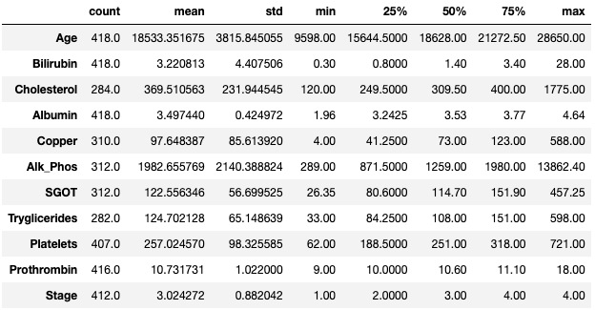
Data Overview

Slide 8
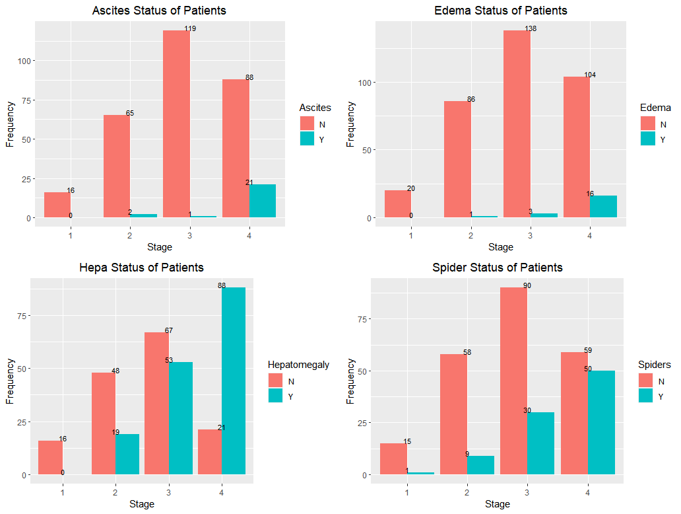
Symptoms Status of Patients of Different Stage

Slide 9
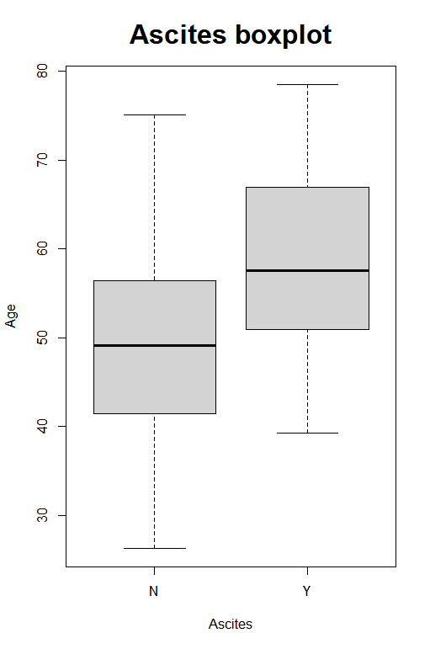
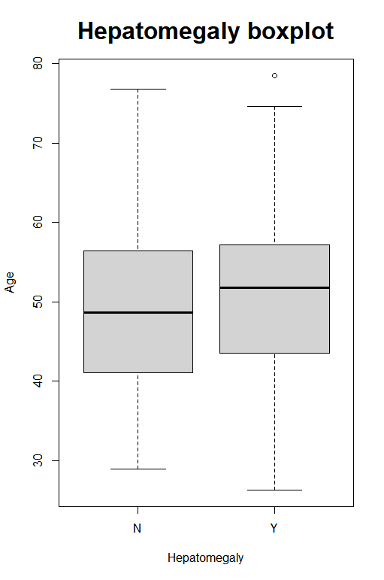
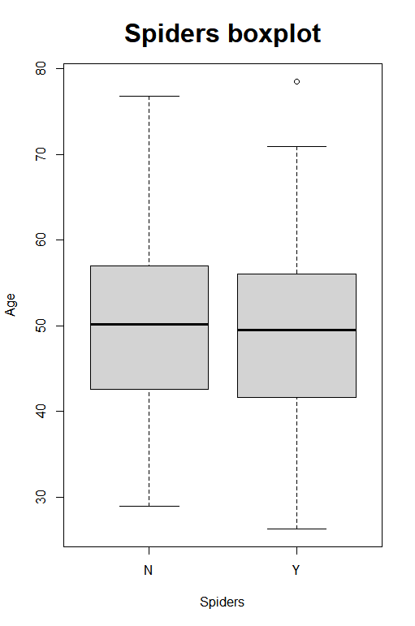
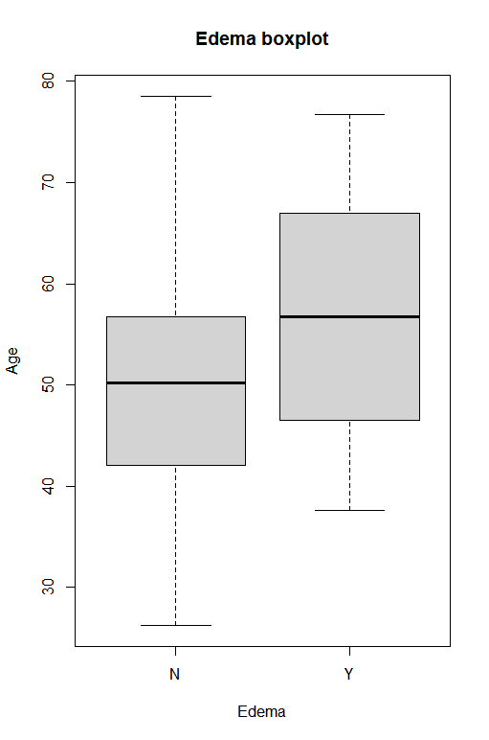
Symptoms Status of Patients of Different Age

Slide 10
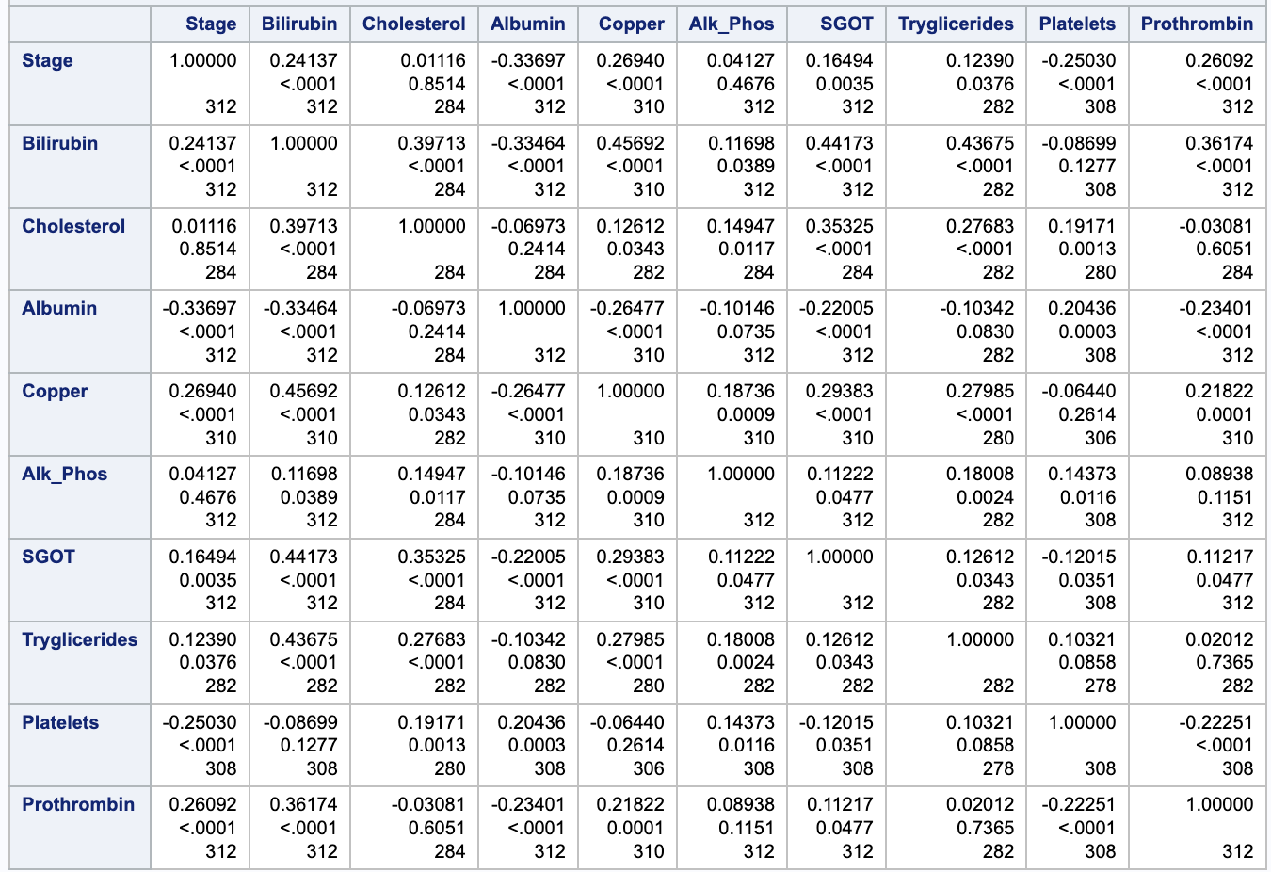
Correlation Table

Slide 11
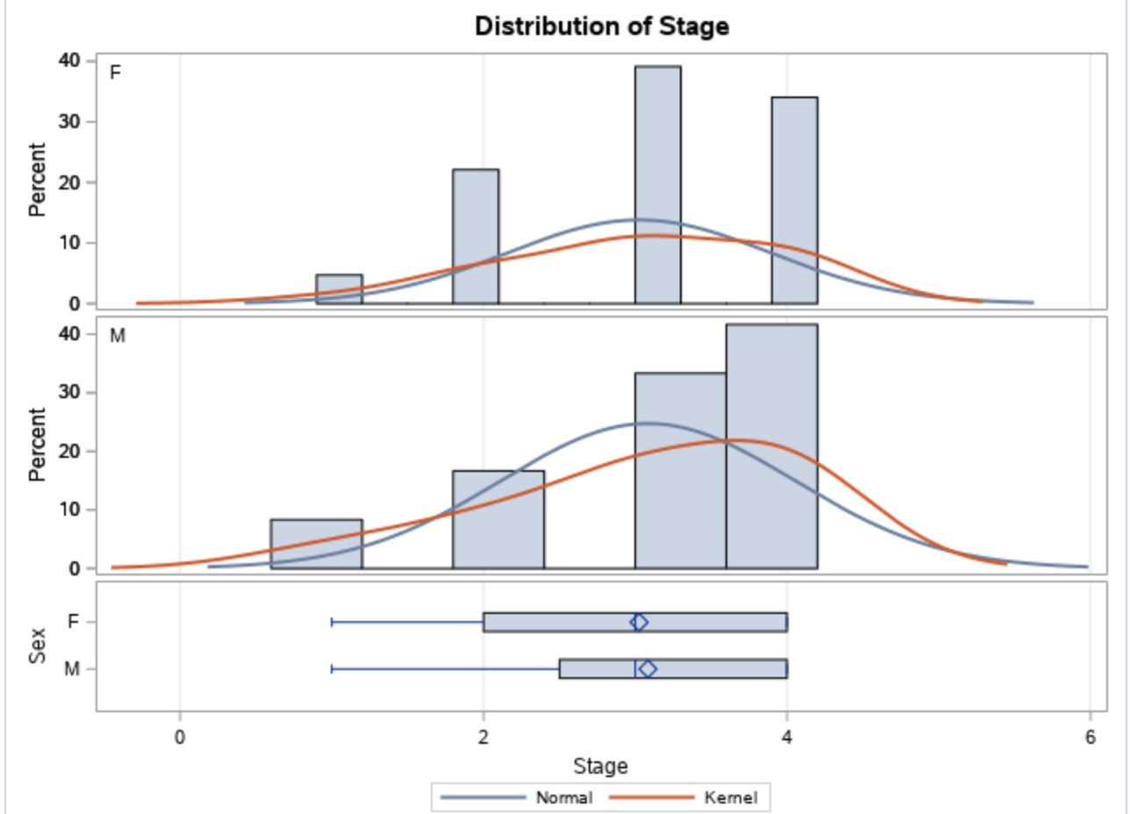
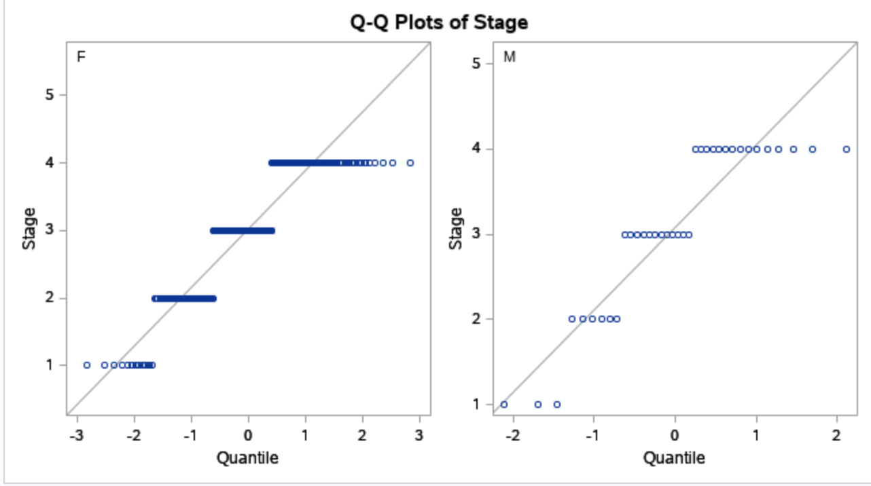
Sex and stages of Cirrhosis
Normality Check:

Slide 12
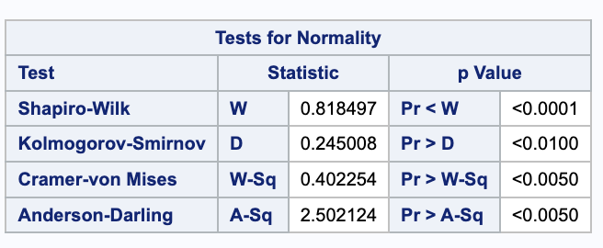
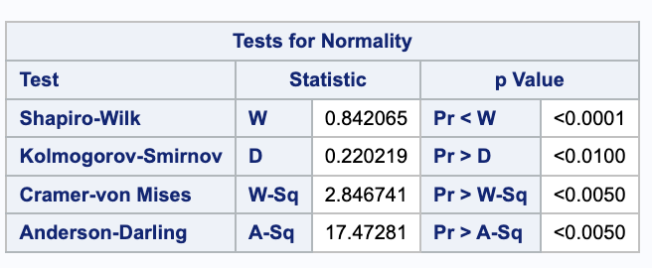
Shapiro Test:
Male Female
Not normal distributed

Slide 13
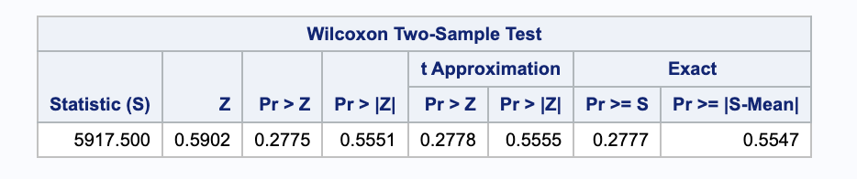
Nonparametric Test
H0: the two populations are identical
Ha: the two populations differ in location
The sex of the patients does have influence on the serouisness of the cirrhosis, male patients are more likely to suffer from higher stage compared to female patients.

Slide 14
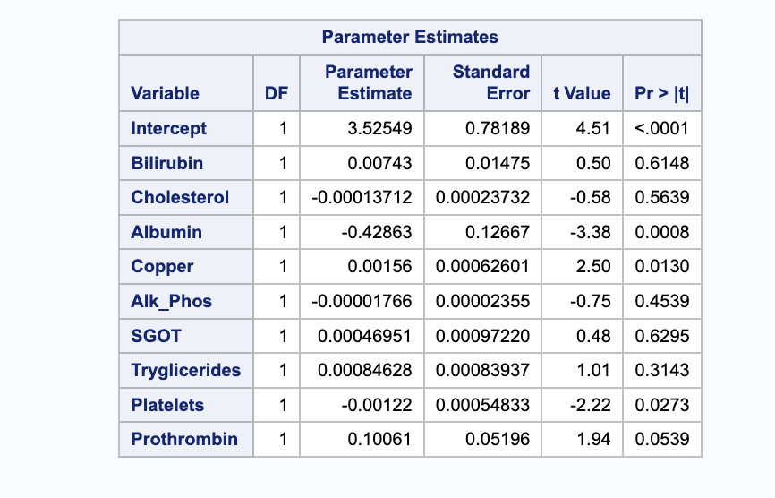
Correlations between element in the blood and stages of the cirrhosis
First we checked the interception model, we found out there is almost no interception affect on the stages of the cirrhosis. Therefore, we further move into the individual factor.
Platelets (negative correlation)
Albumin (negative correlation)
Copper (positive correlation)

Slide 15
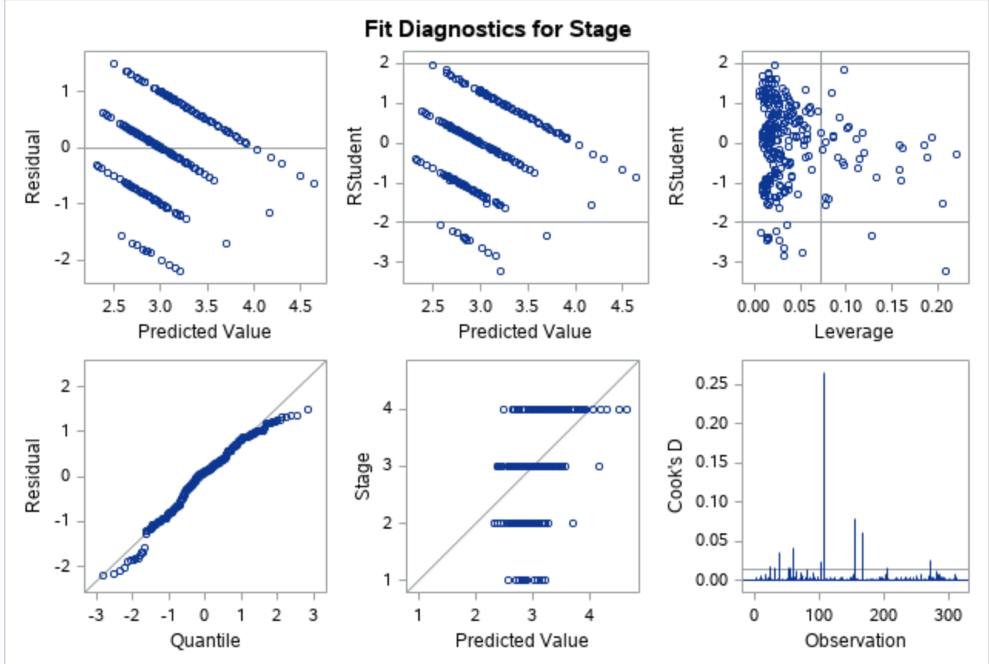
The patient who has lower platelets, lower Albumin, higher Copper is likely to reach the most serious stage of Cirrhosis
100%

Slide 16
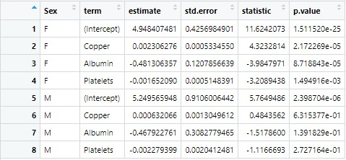
Regression of Different Sex Groups

Slide 17
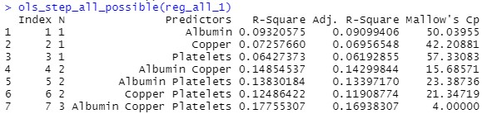
“Best” Subset Method

Slide 18
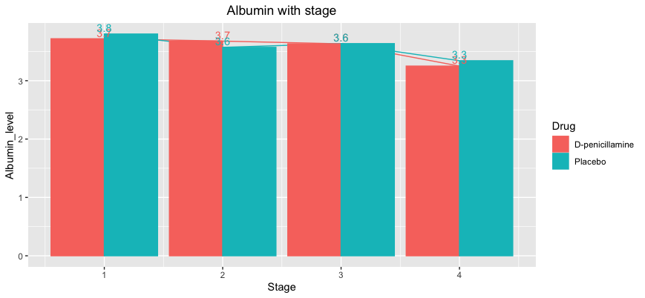
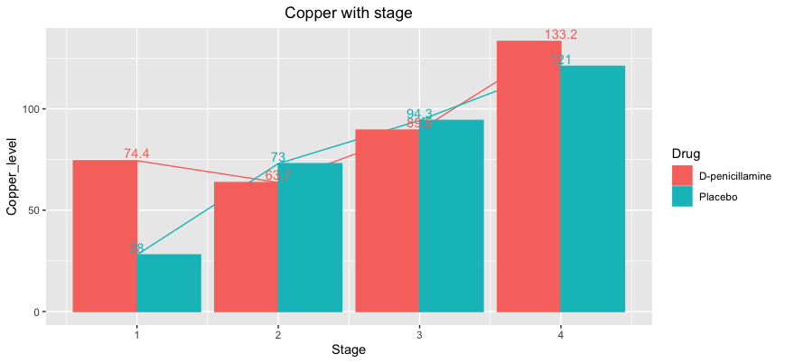
Concentration of Albumin, Copper and Platelets

Slide 19
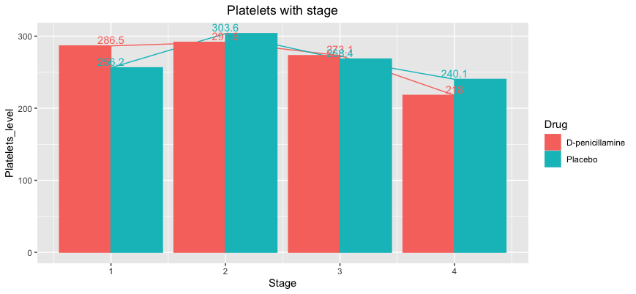
Concentration of Albumin, Copper and Platelets

Slide 20
Conclusion
Male patients are more likely to suffer from higher stage.
Albumin, Copper, and platelets play important roles in liver cirrhosis.

Slide 21
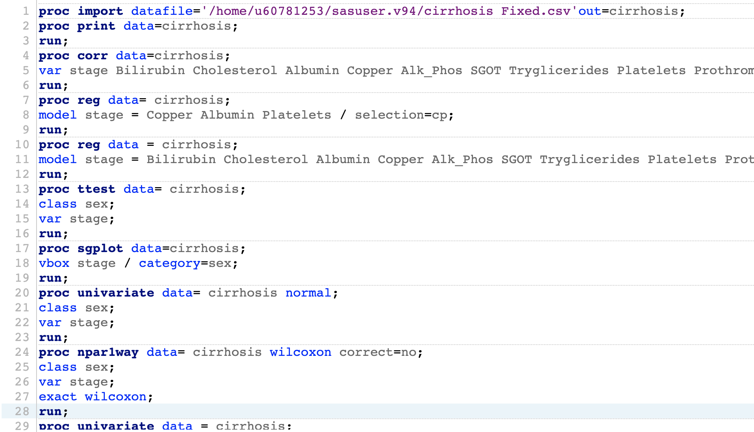
Reference
Code
https://www.statista.com/statistics/827547/number-liver-cirrhosis-deaths-by-cirrhosis-type/
https://www.kaggle.com/code/varshaakshir/liver-cirrhosis-prediction/data

Slide 22
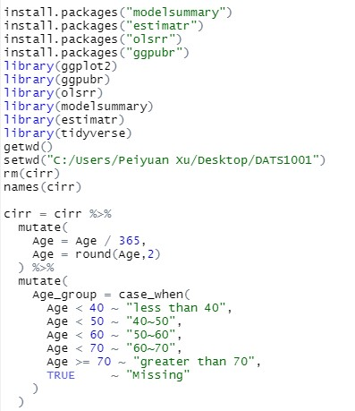
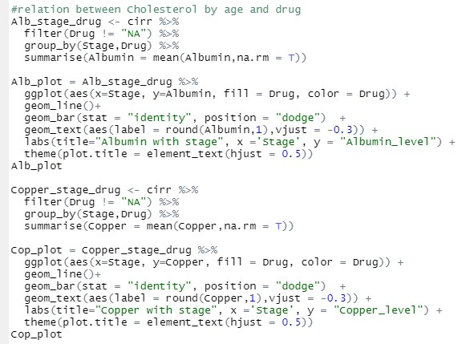
Code

Slide 23
Thank you!

